Slide 1



Engineering Economics| ME 2001 | 3 Credits | 3 0 0 3
Lecture 5-6
Theory of demand and supply analysis
Course Instructor Dr. Vijay S. Kumawat
Assistant Professor, Department of Mechanical Engineering
Engineered Biomedical Materials Research and Innovation Centre (EnBioMatRIC)
School of Automobile, Mechanical and Mechatronics Engineering (SAMME)
Manipal University Jaipur
Ph: +91-9001225135
Email: vijayshankar.Kumawat@jaipur.manipal.edu
: https://scholar.google.com/citations?user=3g9gCscAAAAJ&hl=en
: https://www.linkedin.com/in/vijay-shankar-kumawat-24a02a195
Website: https://www.jaipur.manipal.edu
https://www.enbionac.in/

Slide 2
CHANGE IN QUANTITY DEMANDED Vs. CHANGE IN DEMAND
When the demand for a commodity changes because of the change in its price, it is called ‘change in quantity demanded’. On the other hand, when the change in demand is due to the factors other than its price cause a change it is called ‘change in demand’.
Change in Demand
The shift of the demand curve to the right shows ‘increase in demand’ and a movement of the demand curve to the left of the initial demand curve is a ‘decrease in demand’.
Expansion and Contraction in Demand (Change in quantity demanded)

Slide 3
Concept of Supply
Lecture 3
Supply refers to the quantity of a commodity that producers are willing to sell at different prices per unit of time.
A higher price would mean more profits. The producer will supply more at a higher price.
Similarly, a producer will supply smaller quantity at a lower price.
This is a direct relationship between the price and the quantity supplied of a commodity and is called the ‘Law of Supply’.
A producer aims to maximize profits
Therefore, profit is estimated through difference between total revenue and total cost.
Total revenue is the price of the product multiplied by its quantity sold.
Total cost is the cost of production.
Profit = TR – TC
TR = Total Revenue (q.p)
TC = Total Cost (q.AC)
where AC is average cost.

Slide 4
Determinants of Supply
Lecture 3
Price of the commodity supplied
The price is most immediate determinant of supply.
A person or firm will make quick check whether the costs will be covered by the price. As the price goes up, a firm/person will be willing to sell larger quantity.
2. The prices of factors of production or cost of production
These affect the cost of production and possible profits of the firm. A rise in the prices of factors of production discourages the production and supply of the commodity.
3. Prices of other goods
As the prices of other commodities rise, they become more attractive to produce for a profit maximising firm. Hence supply of commodity whose price is unchanged will decline.

Slide 5
Determinants of Supply
Lecture 3
4. The state of technology
The improvement in the knowledge about the means and the methods of production lead to lower costs of production and helps increasing output.
5. Goals of the producer
The objective with which the producer undertakes production also influences his production and supply decisions.
Price (in Rs) per Pen | Quantity Supplied (in thousand per Month
2 | 25
3 | 40
4 | 50
5 | 60
6 | 70

Slide 6
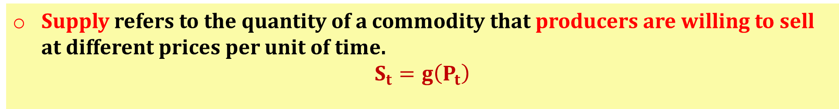
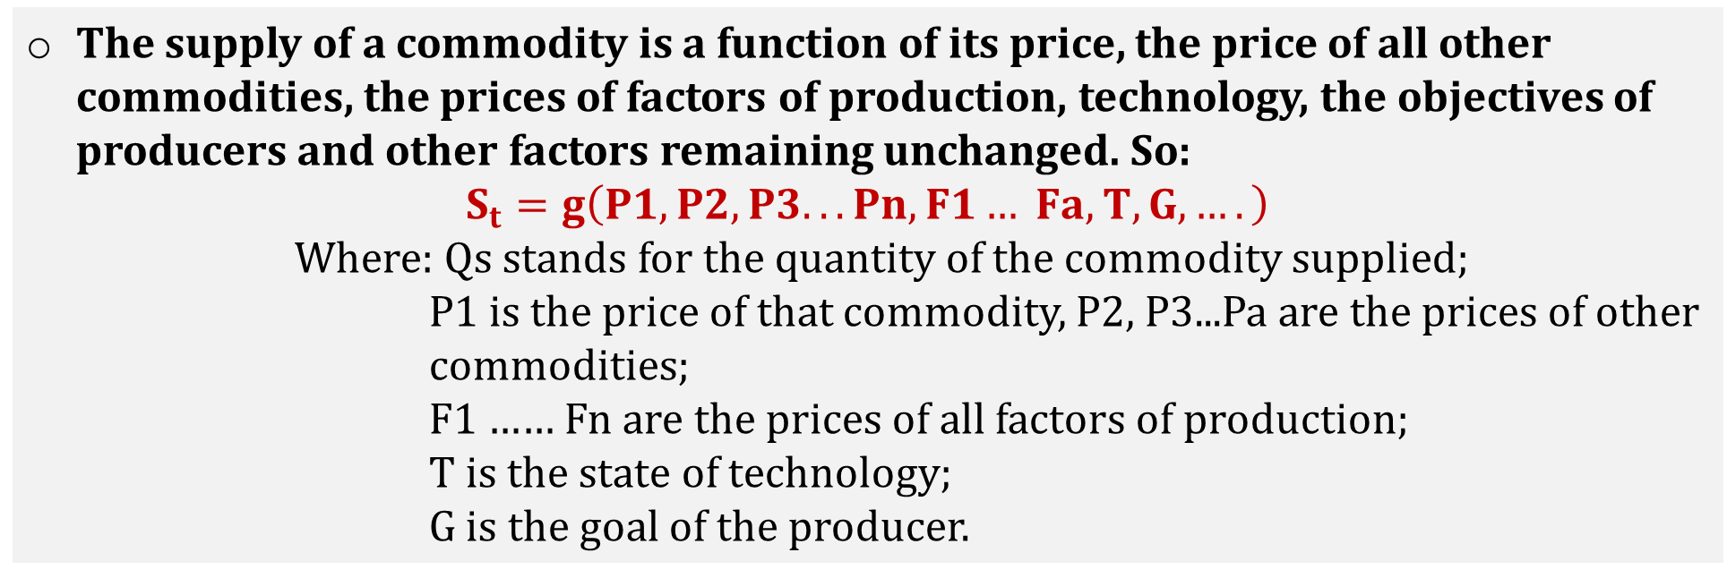
Concept of Supply
Lecture 3
Supply refers to the quantity of a commodity that producers are willing to sell at different prices per unit of time.
$$S_{t}=g\left(P_{t}\right)$$
The supply of a commodity is a function of its price, the price of all other commodities, the prices of factors of production, technology, the objectives of producers and other factors remaining unchanged. So:
$$S_{t}=g\left(P1, P2, P3... Pn, F1… Fa, T, G, ….\right)$$
Where: Qs stands for the quantity of the commodity supplied;
P1 is the price of that commodity, P2, P3...Pa are the prices of other
commodities;
F1 …… Fn are the prices of all factors of production;
T is the state of technology;
G is the goal of the producer.

Slide 7


Engineering Economics
Lecture 2
Engineering economics deals with the methods that enable one to take economic decisions towards minimizing costs and/or maximizing benefits to business organizations.
Key points
Produce goods/services depending on physical law
Example: Technical efficiency of a diesel engine is less than 100%.
This is mainly due to frictional loss and incomplete combustion of fuel
Physical environment
$$Technical Efficiency=\frac{System Output}{System Input}$$
Technical efficiency can never be more than 100%.
Engineering
Worth: Annual revenue generated by way of operating the business.
Cost: Total annual expenses incurred in carrying out the business.
For the survival and growth of any business, the economic efficiency should be more than 100%.
Economic environment
Assessing the worth of these products in economic terms
$$Economic Efficiency=\frac{System Worth}{System Cost}$$

